Slide 1
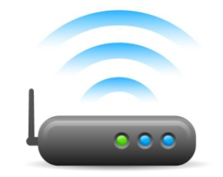
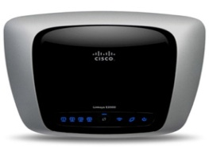
Current Network Schema
Internet
Router
Switch
PC
PC
PC
PC

Slide 2
Pros
Cons
Low Security
Simpler
No control over Traffic
Practical Examples
If something fails it’s simpler to find the problem as there are less layers involved.
A user can take all the bandwidth
Employees can Access anything
Intruders have high privilege on the network.
No way to detect an attacker
Security depends on many machines
A virus in a customer computer can endanger the whole network.

Slide 3
Current Network Schema
Customers Network
Internet
Switch
Router
Switch
ISP Network to BTC
Corporate Network
PC
PC
PC
PC

Slide 4
Final result benefits among others
Every network can have a group of privileges defined that can only be modified from the server.
Every network will be locked on it’s own space but yet with access to what is defined as their right of access.
Security policies regarding the internet access and speed of each network can be applied easily.
A security problem in one network will not affect any other.

Slide 5
Cost and timing
Item | Cost (Euros)
Server | €290
Switch | €80
Other network tools | €78
DMZ service (Firewall) + RAID | €280
(Optional) Samba Server | €300
(Optional) Navigation monitoring service; Proxy | €260
Total exc VAT | €1288
VAT | €154.56
Total | €1 442.56
Green-labor
Blue-Hardware

